Slide 1

ECE 419/619 Electric Machines and Drives Permanent-Magnet Synchronous Machines

Slide 2
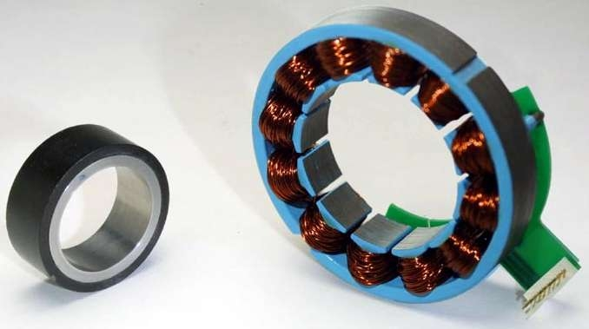
PMSM Rotor and Stator

Slide 3
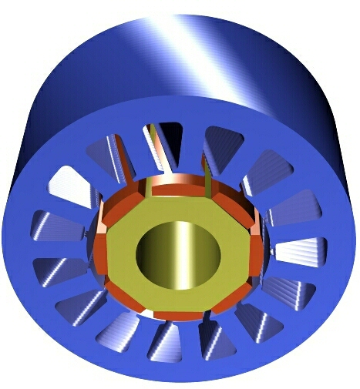
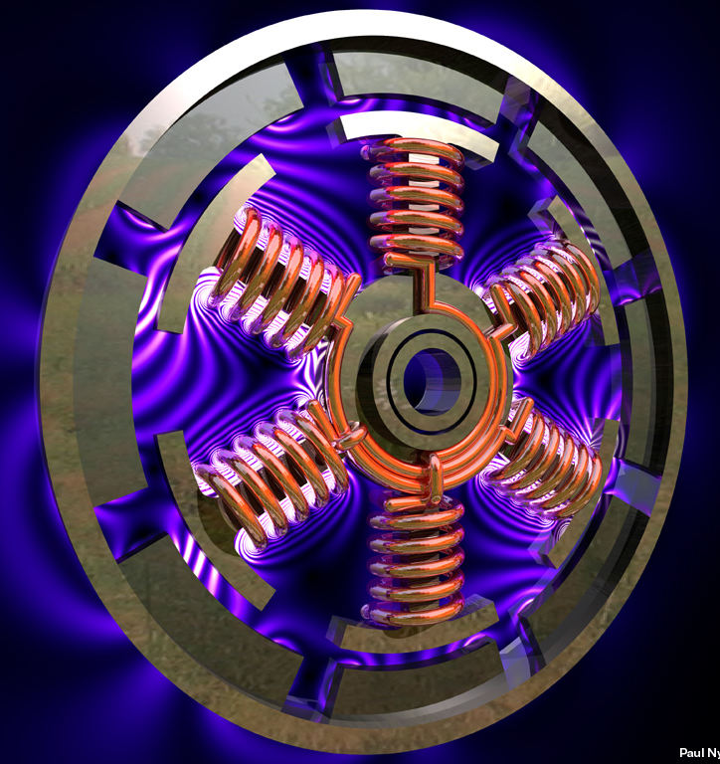
Rotor and Stator Designs

Slide 4

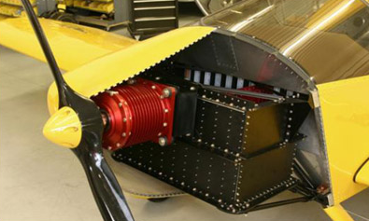

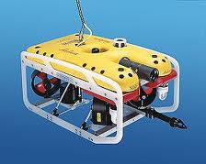
Some PMSM Applications
Electric bike
Electric airplane
Remote operated vehicle
All-terrain vehicle

Slide 5
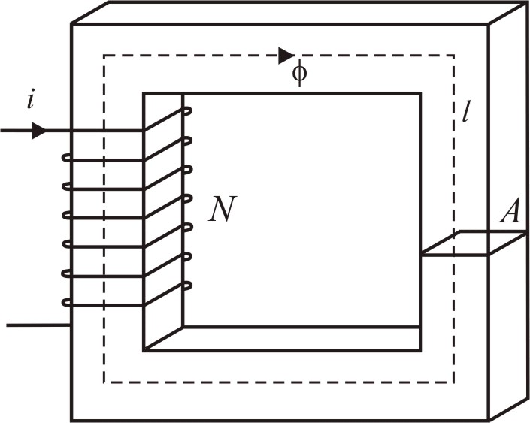
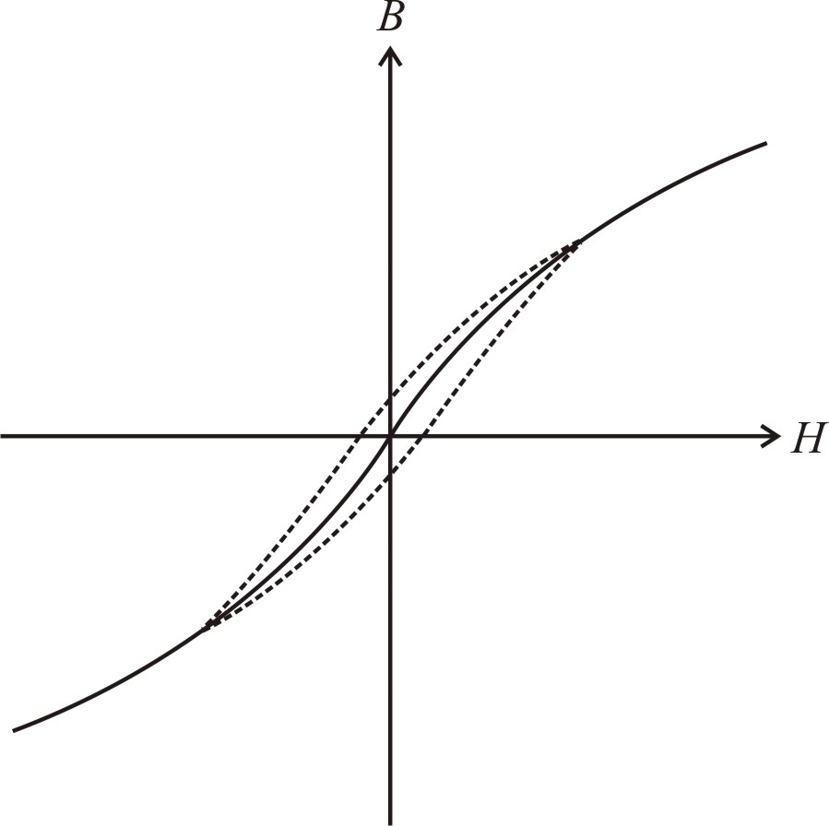
Basic Magnetic Equations
define inductance
flux linkage and current are
proportional to B and H

Slide 6
Basic Magnetic Definitions
= MMF (A∙t)
= reluctance (1/H)
l = flux path length (m)
A = cross sectional area (m²)
μ_{o} = 4π*10⁻⁷ H/m permeability of free space
μ_{r} = relative permeability μ_{r} = 4000 iron, μ_{r} = 2000 steel
Φ = magnetic flux (Wb=V∙sec)
λ = Flux linkage (V∙sec)
L = inductance (H=Ω∙sec)
B = flux density (V∙sec/m²)
H = magnetic field intensity (A∙t/m)
= permeance (H)

Slide 7
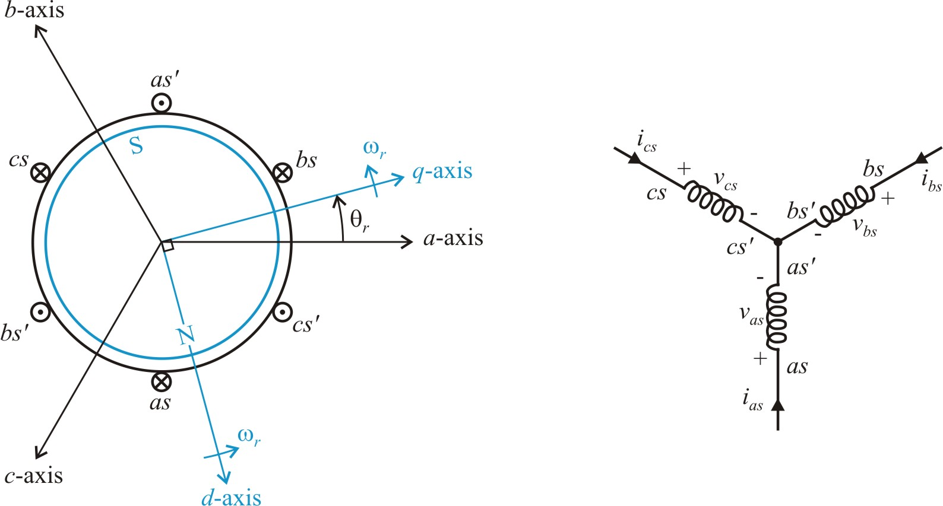
Permanent Magnet Synchronous Machines (PMSMs), Chapter 6
winding connection
motor construction
assume: 1. Round rotor (magnetically)
2. Sinusoidal flux linkages

Slide 8
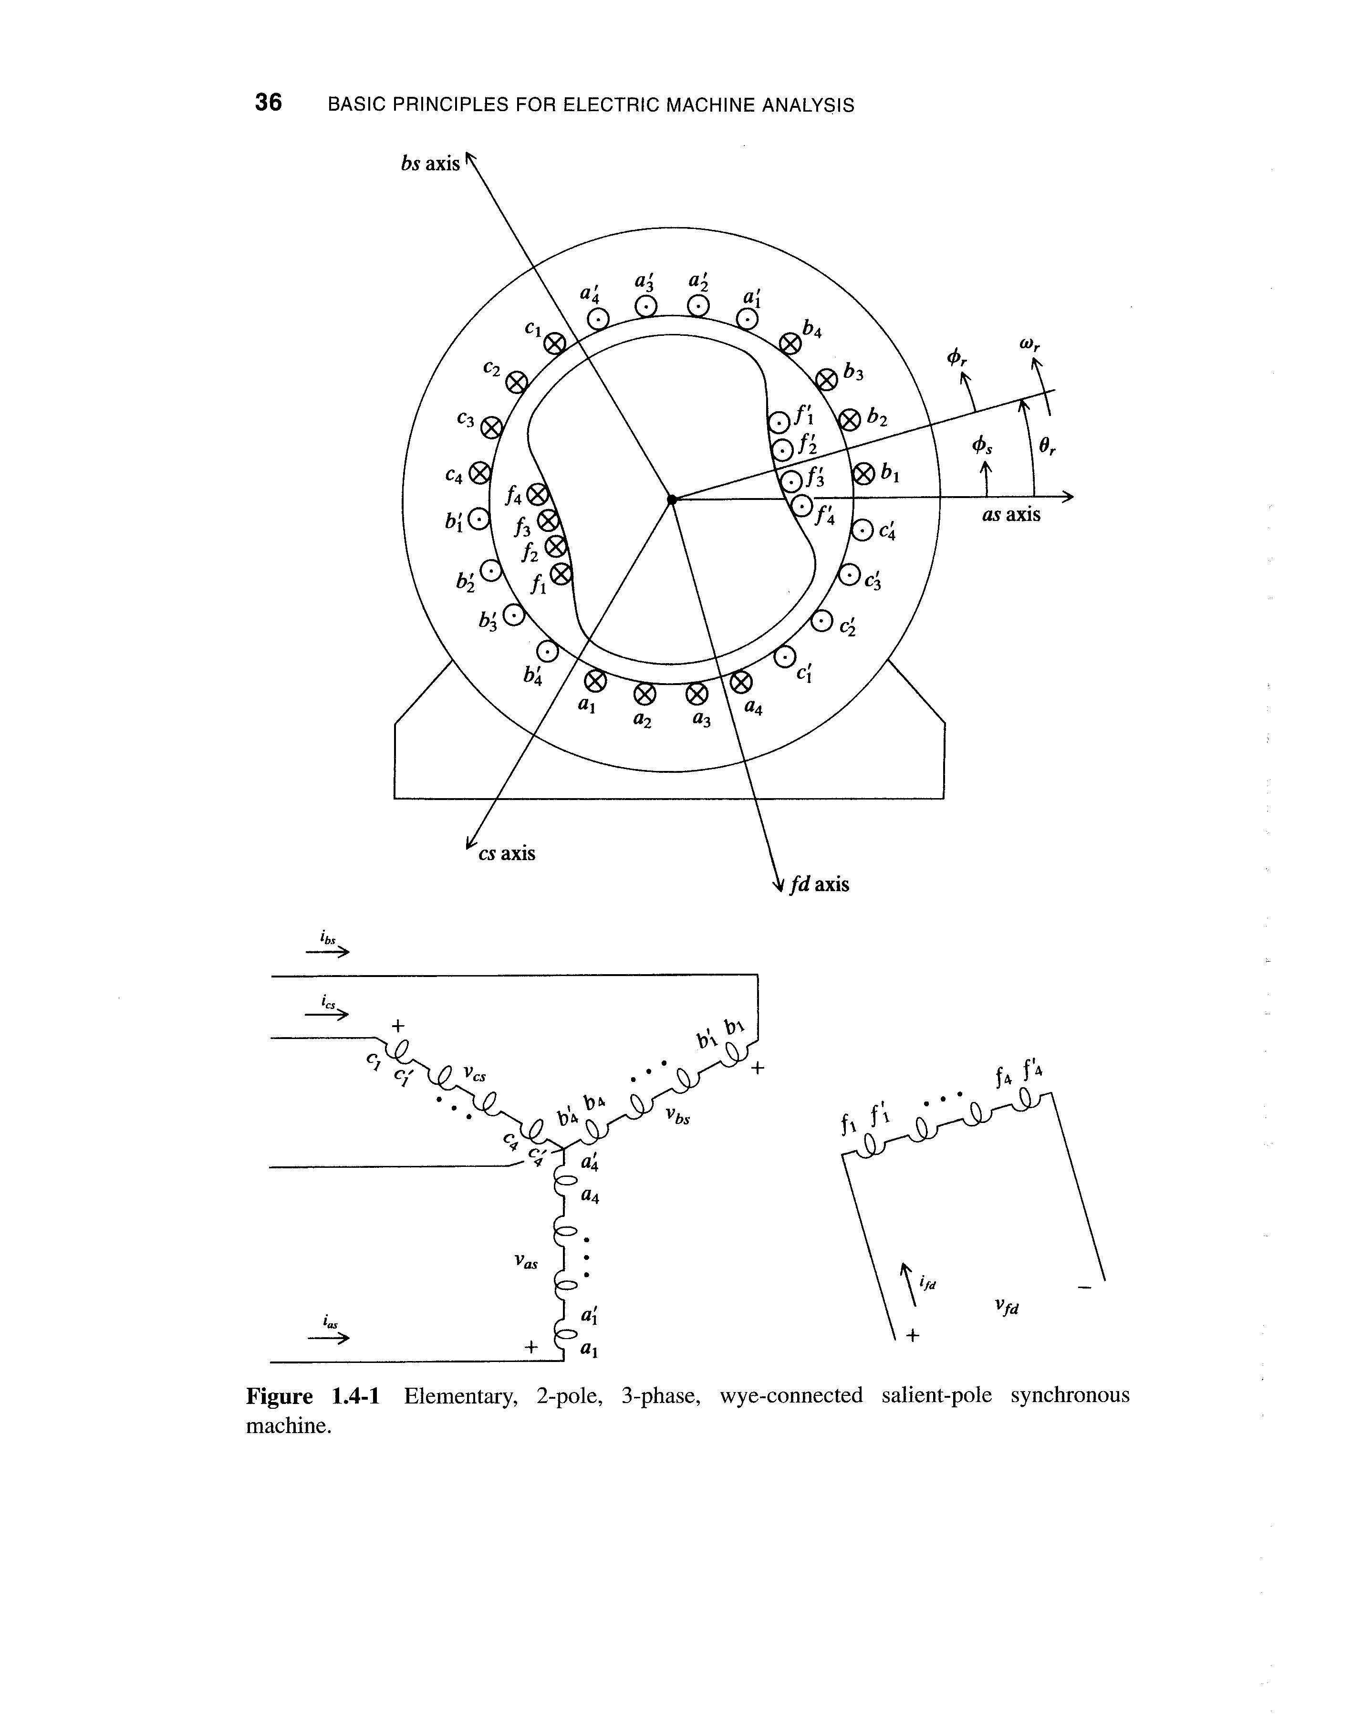
Synchronous Machine Winding Details from Chapter 1

Slide 9
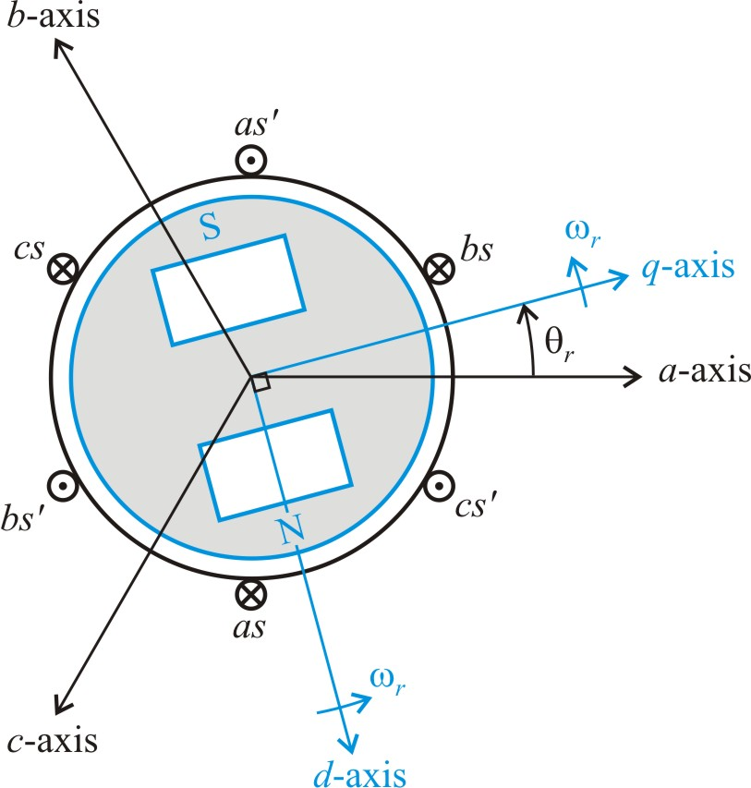
Magnetically Salient PM Machines
different inductances for the
q- and d-axes (typically L_{mq} > L_{md})

Slide 10
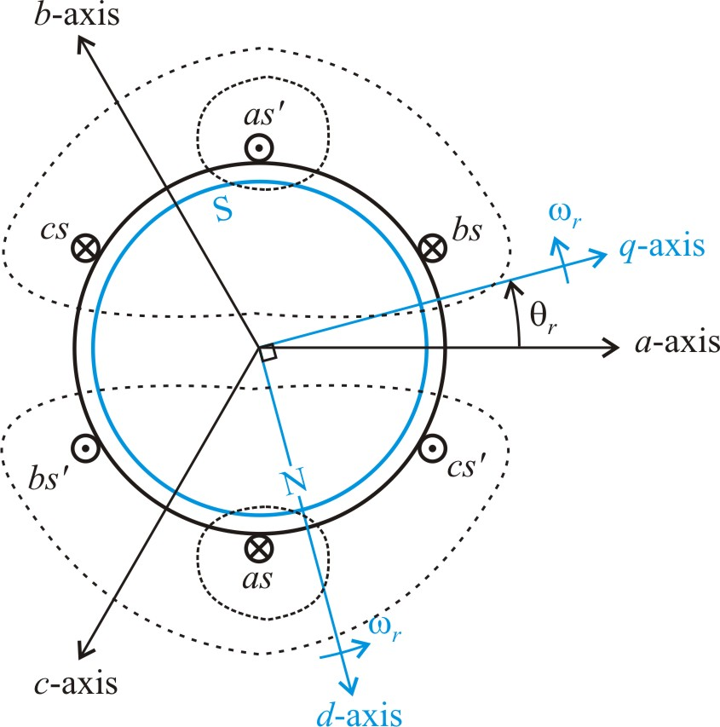
Inductance Terms
consider a current in the a-phase winding
self inductance L_{asas}
- stator leakage inductance (H)
stator magnetizing inductance (H)
mutual inductance L_{asbs} (determines the component of λ_{as} due to i_{bs})
remaining inductance terms

Slide 11
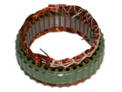

Inductance Related to Machine Dimensions
From Chapter 1

Slide 12
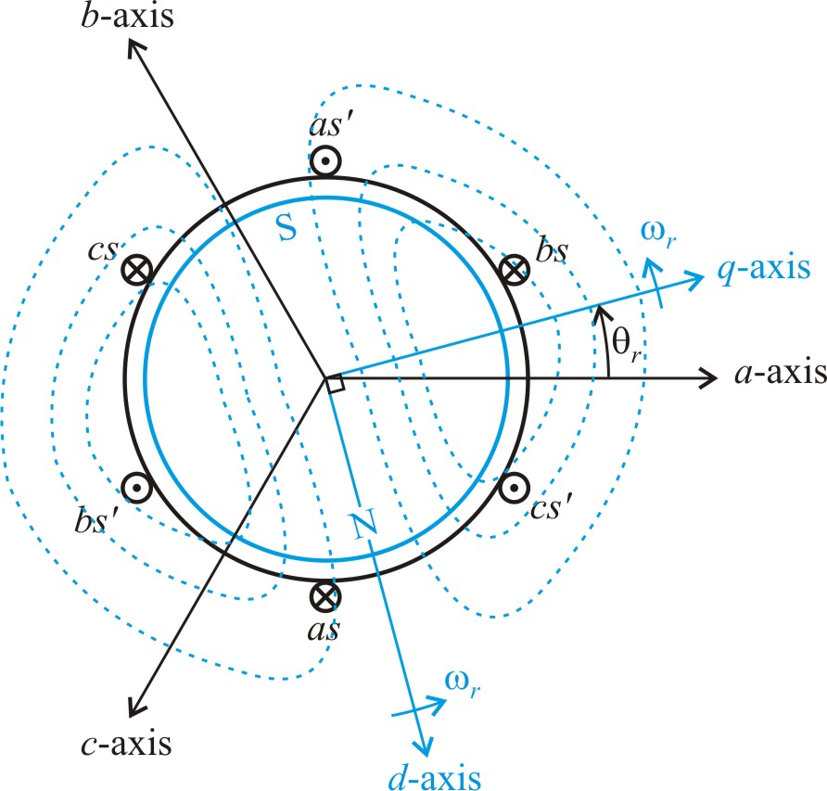
Magnet Flux
magnet flux linking the a-phase
magnet flux linking the b- and c-phase

Slide 13
PMSM Equations
machine coil variables
flux linkages

Slide 14
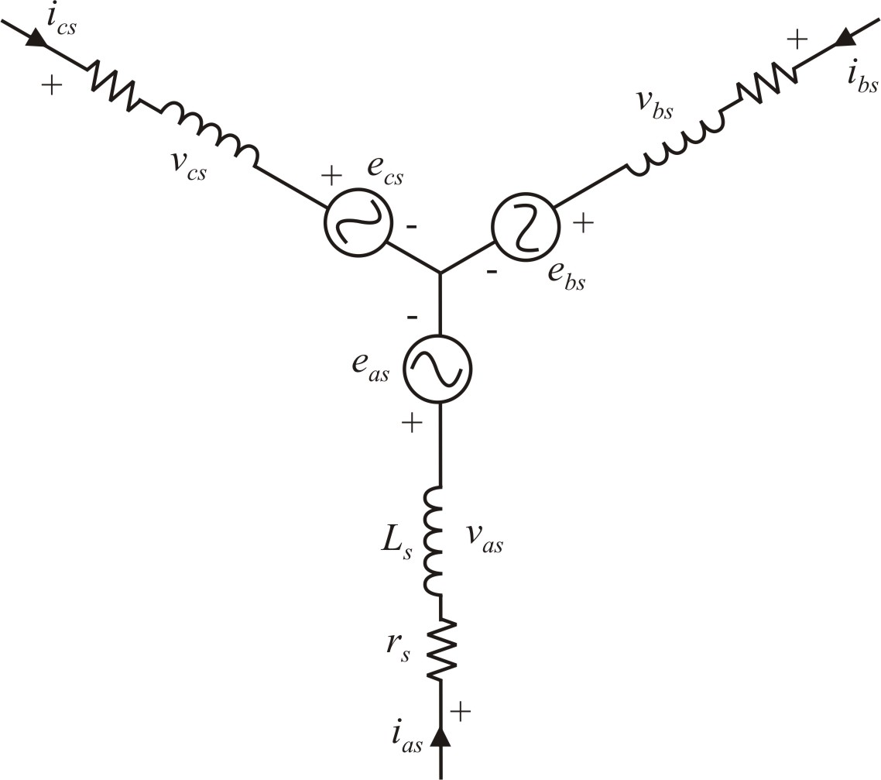
Reduced Flux Linkage Equations
for a wye connection,
i_{as} + i_{bs} + i_{cs} = 0
where L_{s} = L_{ls} + (3/2)L_{ms}
e_{as} - a-phase back-emf

Slide 15
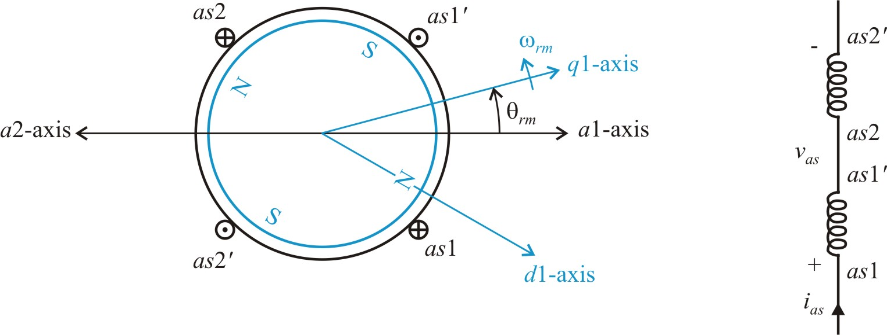
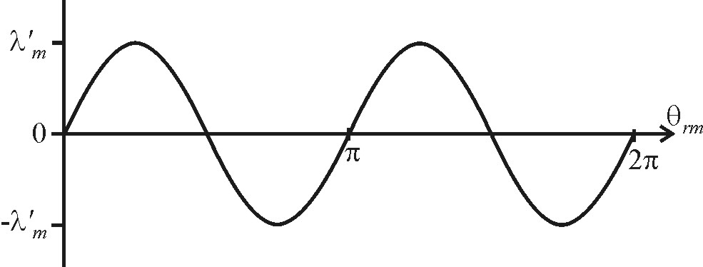
Four-Pole PMSM
plot a-phase flux linkage from the rotor magnet
Note: One mechanical cycle of θ_{rm} is two electrical cycles of θ_{r}

Slide 16
General Machine with P Poles
θ_{r} - electrical rotor position (rad)
θ_{rm} - mechanical rotor position (rad)
ω_{r} - electrical rotor speed (rad/sec)
ω_{rm} - mechanical rotor speed (rad/sec)

Slide 17
Torque Equation from Power

Slide 18
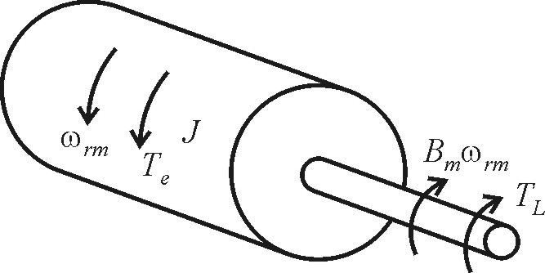
Mechanical Equations
also
T_{e} - electrical torque (N∙m)
B_{m} - friction constant (Kg∙m²/sec)
J - total inertia (Kg∙m²)
ω_{rm} - mechanical speed (rad/sec)
T_{L} - load torque (N∙m)
θ_{rm} - mechanical rotor position (rad)

Slide 19
PMSM Model
The PMSM can be modeled with a fairly straightforward resistance, inductance, and back-emf term in each phase. At this stage, saliency is neglected in the model.
Electrical speed is related to mechanical speed by the number of poles.

Slide 20
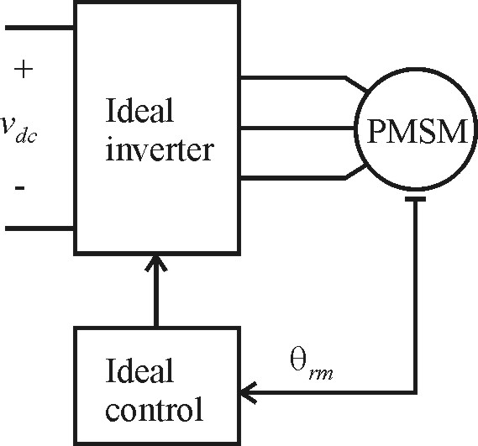
PMSM with Ideal Drive (Steady-State)
inverter voltages
resulting currents
using the trig identity,
torque is

Slide 21
PMSM Steady-State Per-Phase Equations
phasor notation
torque and mechanical equations

Slide 22
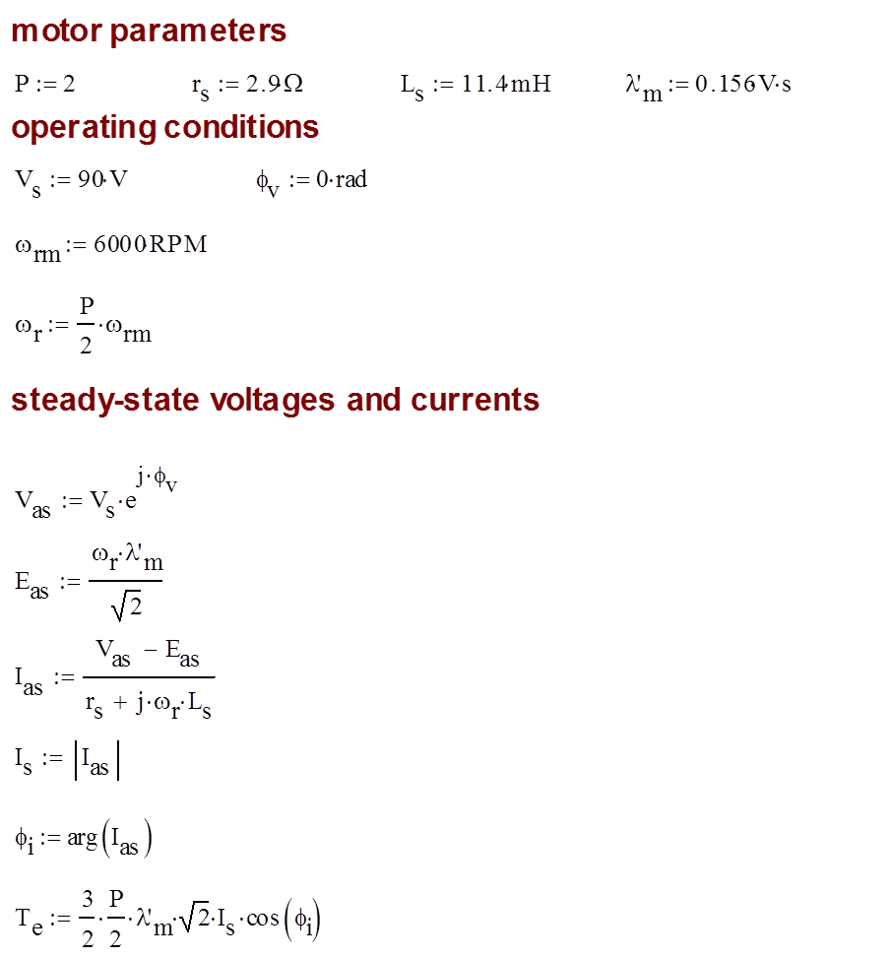
Ideal Drive Calculations with φ_{v} = 0

Slide 23
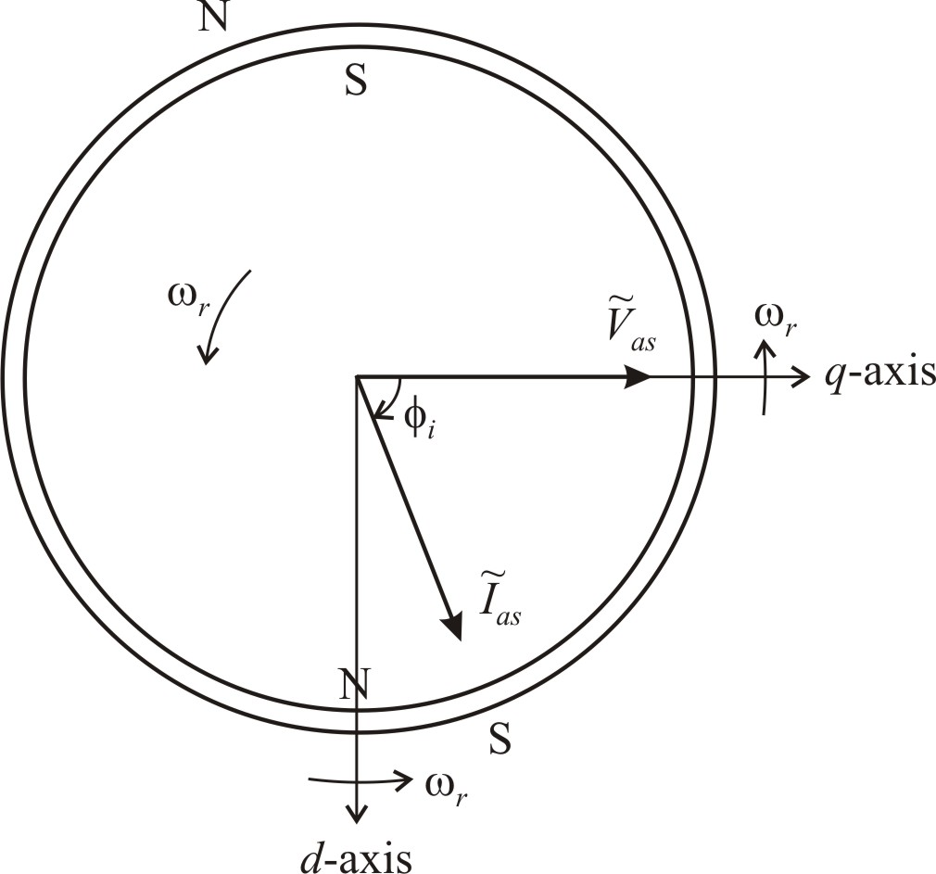
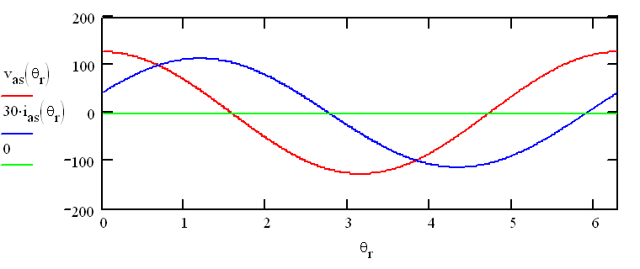
PMSM Steady-Sate Example φ_{v}=0

Slide 24
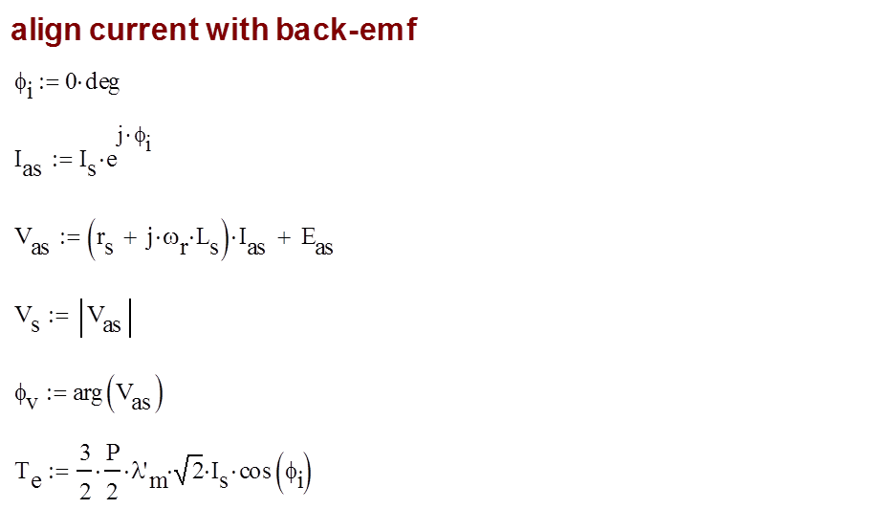
Ideal Drive Calculations with φ_{i} = 0

Slide 25
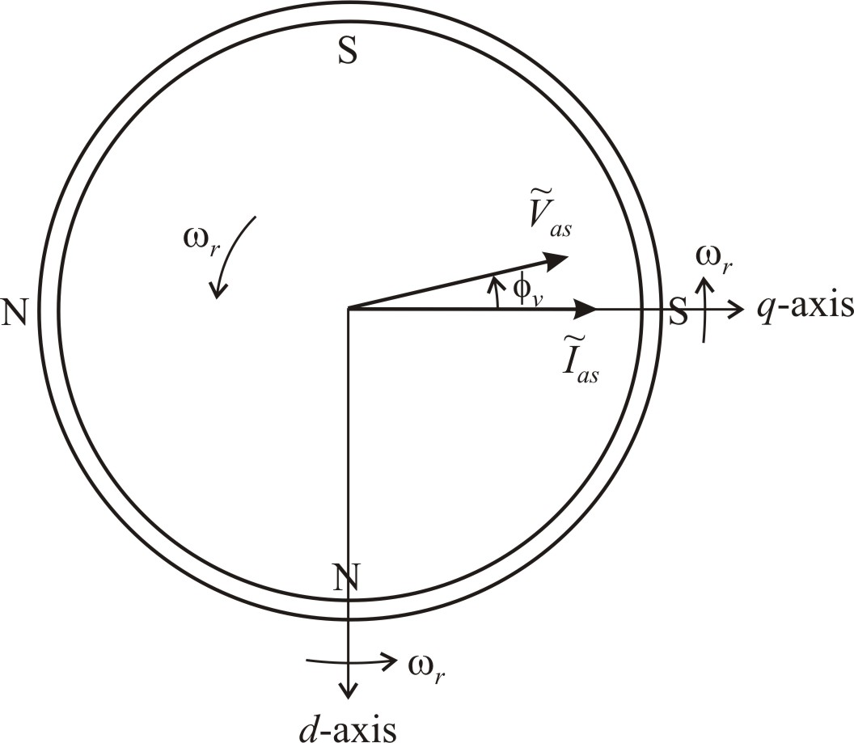
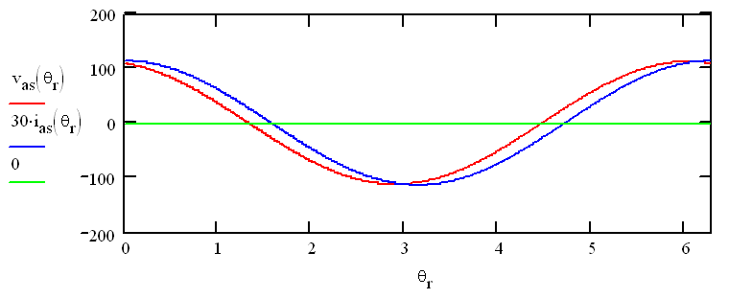
PMSM Steady-Sate Example with φ_{i} = 0

Slide 26
PMSM Steady-State Operation
Ideal drive controls magnitude and phase of PMSM stator voltages relative to rotor position. This brushless dc concepts places stator poles relative to rotor poles to develop torque.
Steady-state equations readily determine voltage, current, torque, and speed.

Slide 27
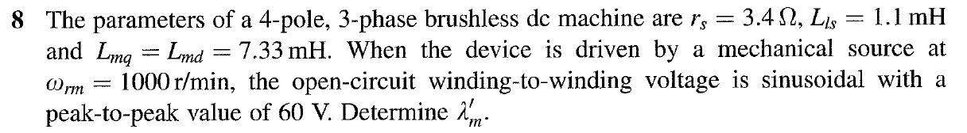
Chapter 6, Problem 8
assume wye connection
with

Slide 28
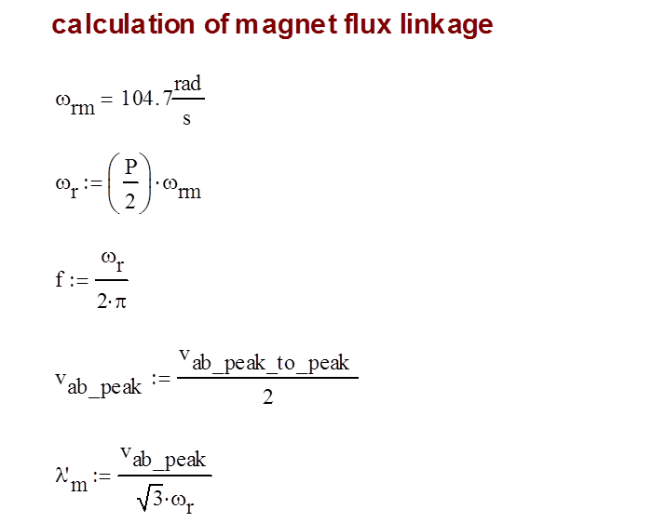
Chapter 6, Problem 8

